Slide 1
Quad Coders
Jishnu P S
Jerry Boby
Krishna Sreeraj
Kavya Raveendran

Slide 2
Problem Statement:
The road conditions in India is really worse especially in the roads less travelled by. People don’t inform the authorities about it. Our module could be placed in a car so that the pressure variations while travelling through potholes would be recorded and the ones above a threshold value would be sent to the authorities along with the location. So that they can take the necessary actions.

Slide 3
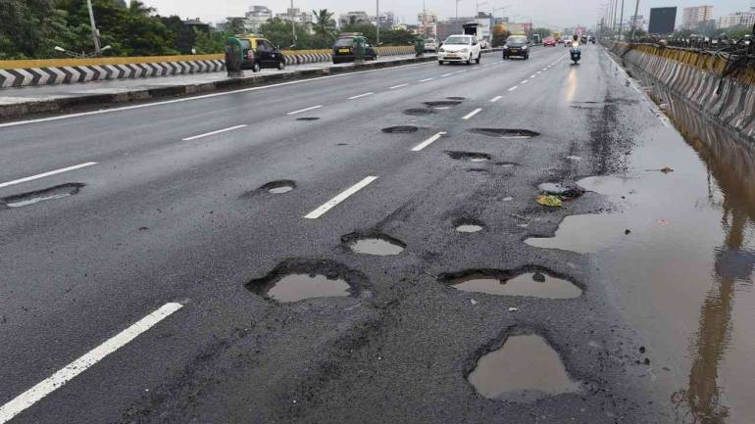

Slide 4
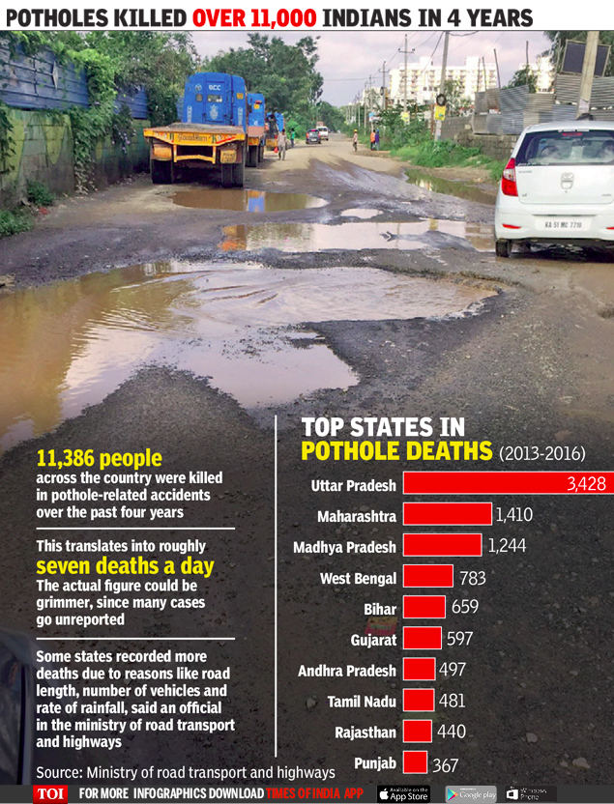

Slide 5
Completeness of expected output
Even though we couldn’t develop a hardware, we were able to express our idea at a basic level.

Slide 6
Architecture
Pressure Variations noted by the sensor
Detects the potholes
Is variations > desired variation
Sent the Details to the authority
Yes
No
Ignore

Slide 7
Technologies Used
Java

Slide 8
Project Split-Up
Jerry Boby - Coding, Idea Presentation
Jishnu P S - Main Coder
Kavya Raveendran - Coding, PPT
Krishna Sreeraj - Coding, PPT

Slide 9
Working
The pressure sensor placed on the shock absorber of the vehicle detects the holes when there is a pressure variation.
Get the location where there is a hole using GPS.
The locations and the pressure variations of the roads with holes are recorded.

Slide 10
Sent the data of holes having pressure variations that are greater than a threshold value considered normal, to the PWD Department.
They sent workmen to clear the potholes.
The problem thus gets solved.

Slide 11
Issues Faced
Didn’t have necessary knowledge about the programming language.
Took more time to learn.
Didn’t have enough knowledge to implement it through a hardware.
Couldn’t provide a graphical interface.

Slide 12
Uniqueness
The module would help to keep the road safe always.
Necessary action can be taken by the authorities.
Require less human intervention.
User friendly.

Slide 13
Market Feasibility
Sensors are available in the market.
Customers should not be given a choice to opt whether the module to be placed in the vehicle. It would be beneficial if the module is placed in the vehicle during manufacture.
Once the road gets repaired, the number of accidents as well as the damages to vehicles are reduced.

Slide 14
Thank you

